Slide 1
《英语国家社会与文化入门》(下册）
The Society and Culture
of Major English-Speaking Countries
An Introduction
(Book Two)

Slide 2
The United States of America Unit 16 American Popular Culture: Movies and Music

Slide 3
Quiz
Give the English and a brief explanation for the following:
美国早期电影
好莱坞制片厂时代
美国电影全球化
爵士乐
“猫王”与早期摇滚乐
迪伦与60年代美国民谣
嘻哈乐与21世纪美国民族身份

Slide 4
Focal Points
Early American film
the Hollywood studio era
the Star System in American film industry
American cinema in the age of globalization
Jazz and American national identity
Alan Freed and the beginning of rock ‘n’ roll
Bob Dylan as a transformative force in U.S. pop music
Hip hop music as a cultural movement

Slide 5
This Unit Is Divided into Five Sections
I. The Early Years of American Films
II. The Hollywood Studio Era
III. Hollywood in the Post-Studio Era
IV. American Popular Music since 1900
American Popular Music since the 1950s

Slide 6
I. The Early Years of American Films
American popular culture defined:
originally known as the culture for the low classes;
also known as Mass Culture, and seen as a commercial culture, mass produced for mass consumption;
popular culture associated with commercial culture in post-World War II America,;
Popular Culture evolving since the 1960s;
American Popular Culture expressing itself through nearly every medium, including movies, and music.

Slide 7
I. The Early Years of American Films
Early American films:
-The French Lumiere brothers were the first to project motion pictures in 1895 with their Cinmatographe.
-Thomas Edison of the United States invented the Vitascope based on the French model.
-The early films were shown during the vaudeville shows and arcades.
-They were short films to showcase America’s scenic views, glimpses of personalities, bits of daily life, jokes, news items, and social events.

Slide 8
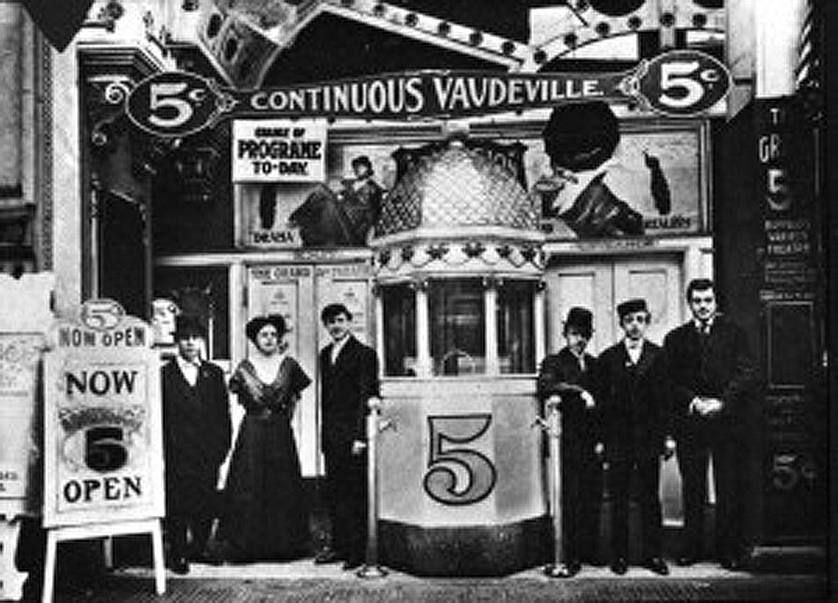
I. The Early Years of American Films
Films were screened by exhibitors which rented the prints through film exchanges.
The first American movie theaters opened in Pittsburgh in 1905. They were called “nickelodeons” where film goers were charged five cents for admission.

Slide 9
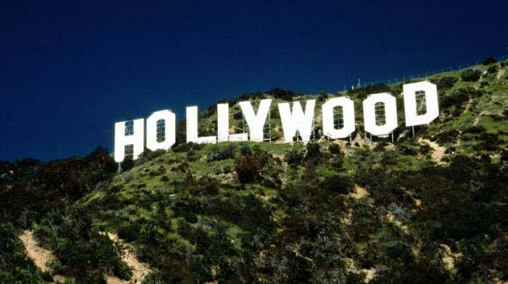
I. The Early Years of American Films
The first American studios were built in the New York City area.
In 1909, Edison formed the Motion Picture Patents Company.
Meanwhile, many small film companies moved their studios to Los Angeles’ Hollywood.

Slide 10
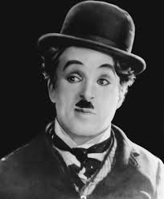
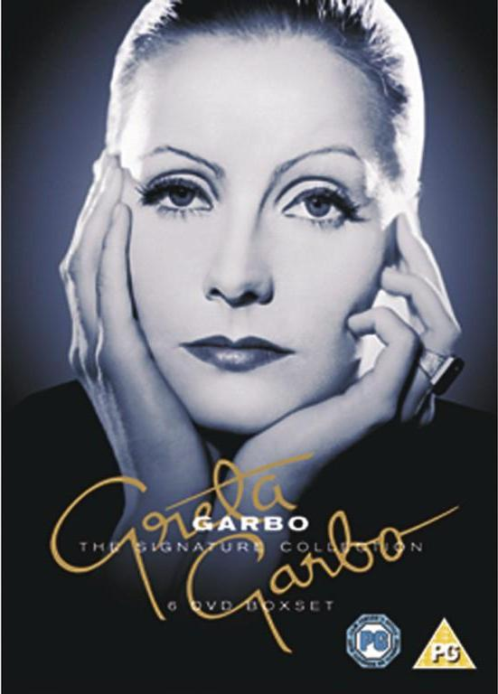
I. The Early Years of American Films
Charlie Chaplin （1889-1977）
Greta Garbo （1905-1990）

Slide 11
The five “major” Hollywood studios: Fox，MGM，Paramount，RKO, and Warner Brothers

Slide 12
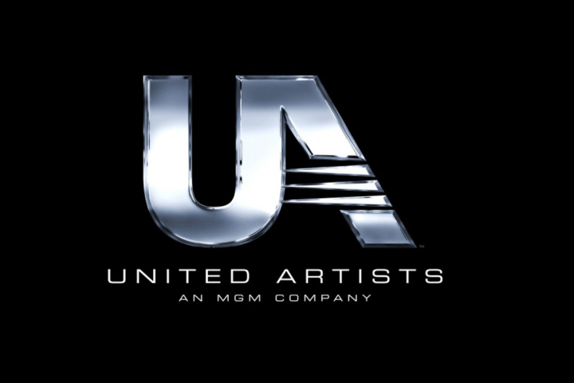
The “little three” studios: Columbia, Universal and United Artists

Slide 13
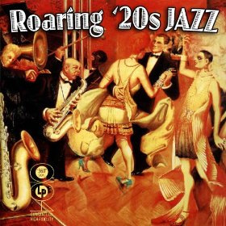
II. The Hollywood Studio Era
American films prior to World War I had often been preachy and sentimental, set in a working-class milieu, while those made in the 1920s reflected changing social and moral standards.
Cynicism and sensuality among the upper classes characterized many of the Jazz Age of the 1920s.
Hollywood during the Jazz Age

Slide 14
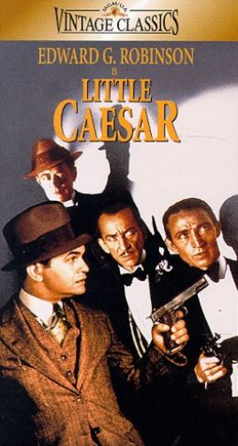
II. The Hollywood Studio Era
A new genre called gangster films that glorified criminals emerged. They dealt with the urban environment – specifically, the criminal big-city life.
The gangster figure in this 1930s genre film represented the ultimate rebel. He refused to accept Depression-imposed privations.

Slide 15
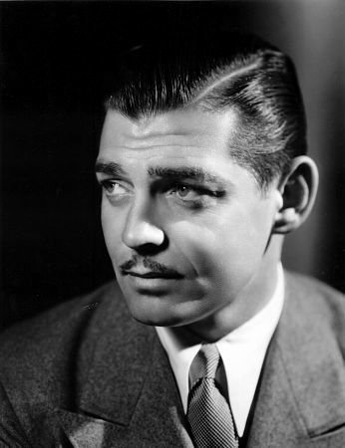
II. The Hollywood Studio Era
In 1928, the first all-talking picture, Lights of New York, was shown. With the talkies new directors, including King Vidor, Frank Capra, and John Ford, achieved prominence.
Sound films gave a tremendous boost to the careers of some silent actors.
Among the most celebrated stars of the new era were Clark Gable, Jean Harlow, and the Marx Brothers.
Clark Gable（1901-1960）

Slide 16
II. The Hollywood Studio Era
The film industry was impacted by the Great Depression, with much of the industry facing bankruptcy.
Hollywood, however, had fully recovered economically by the late 1930s and entered into an artistic golden age.
Among the 1930s’ most notable actors were the child star Shirley Temple, and the most popular film of this period was Gone with the Wind in 1939.

Slide 17
II. The Hollywood Studio Era
In 1927, the Motion Picture Academy of Arts and Sciences was formed and began to award those who excelled in the art of performing and filmmaking.
The prize, a figurine of a man grasping a star, was later dubbed Oscar.
These awards confer status and glory upon those performing artists whose performance excels in acting, directing, and editing and many others.

Slide 18
III. Hollywood in the Post-Studio Era
In the 1950s, two developments ended the studios’ control of the entertainment business: the overwhelming popularity of television began to eat into studio profits; the studios were forced by Federal court rulings to abandon the control of distribution and exhibition through massive conglomerate corporations.
The movies of the 1950s and 60s were marked by an increased sense of realism, providing vehicles for new directors and new actors.
New genre films emerged: horror, science fiction, and rock ‘n’ roll stories aimed at teen-agers became popular.
Meanwhile, larger studio-backed films tried to evade the long-imposed bans on depictions of a harsher reality and a more explicit sexuality.

Slide 19
III. Hollywood in the Post-Studio Era
Marlon Brando (1924-2004)
Marilyn Monroe (1926-1962)

Slide 20
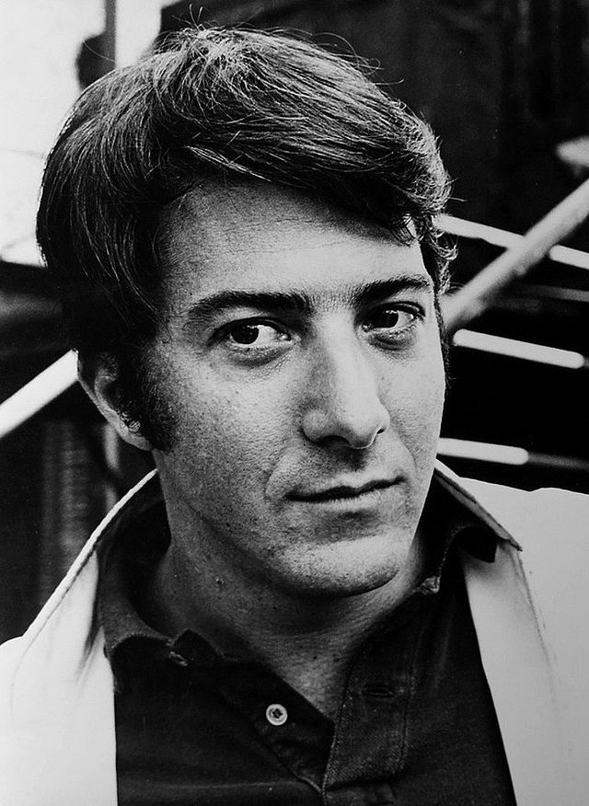
III. Hollywood in the Post-Studio Era
The trend away from the glamorous celebrity image that began in the 1960s continued into the 1970s and 1980s.
The principal stars of these years include Jane Fonda, Barbra Streisand, Dustin Hoffman, and Woody Allen.
Important American directors of the 1970s, 80s, and 90s include Francis Ford Coppola, Robert Altman, and Martin Scorsese.
Dustin Hoffman (1957-)

Slide 21
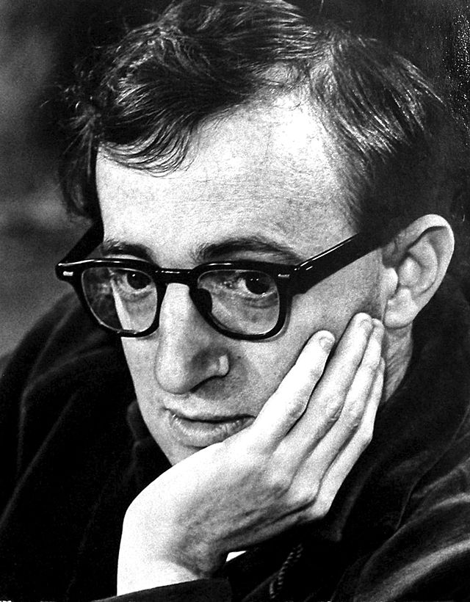
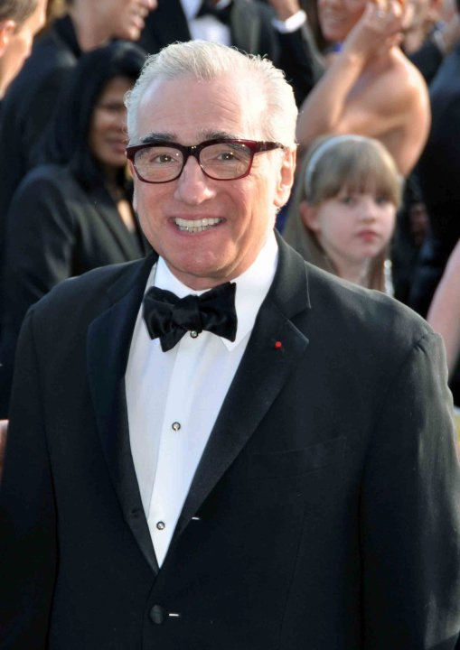
III. Hollywood in the Post-Studio Era
Woody Allen (1935-)
Martin Scorsese (1942-)

Slide 22
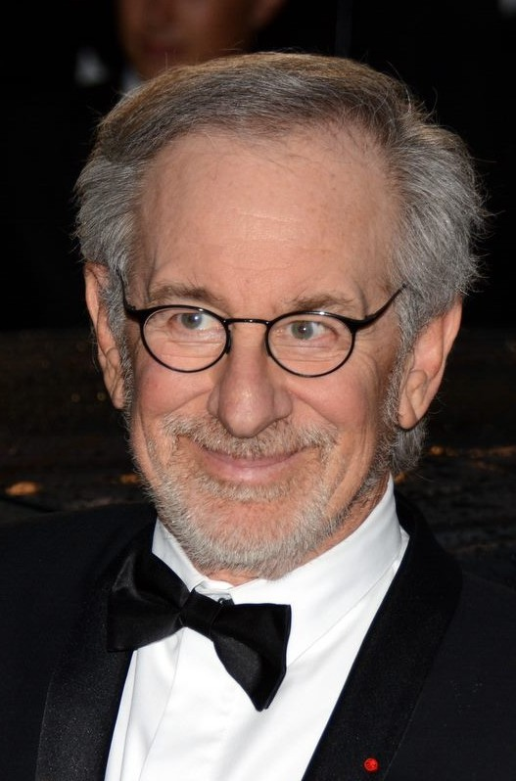
III. Hollywood in the Post-Studio Era
The Age of huge blockbusters :
The release of Jaws (1975), a suspense picture directed by Steven Spielberg grossed over $100 million by appealing to all ages and both sexes. The result is that it ushered into a new age in movie making.
Films such as Star Wars (1977), and E.T. (1982) began to generate huge box office revenues.
Director Steven Spielberg (1946-)

Slide 23
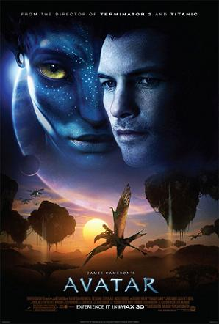
III. Hollywood in the Post-Studio Era
The American Film Industry goes Global:
The American film industry has gone global, with co-production of foreign language films gaining popularity in both English-speaking and non-English speaking markets. There has been a revival in 3D film popularity, the first being Avatar directed by James Cameron in 2009 .

Slide 24
IV. American Popular Music since the 1900
Early19th century saw the emergence of distinctive styles of American popular music, and it continued to develop in the first five decades of the 20th century .
Both traditional forms of pop music,such as blues and folk, and the new styles,including country, R&B, jazz and rock, later hip hop help to express an American national identity.

Slide 25
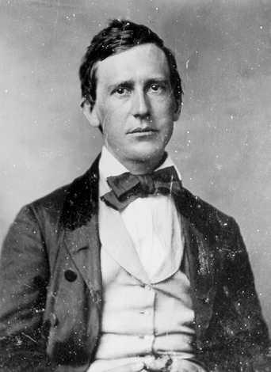
IV. American Popular Music since 1900
American popular music began with sentimental parlor songs by Stephen Foster, and songs for the vaudeville stage for middle- and working-class white audiences.
Black people also had been part of the popular cultural scene prior to the Civil War era. In New Orleans, black marching bands played the syncopated rhythm that became characteristic of early jazz.
Stephen Collins Foster (1826 –1864), known as "the father of American music”

Slide 26
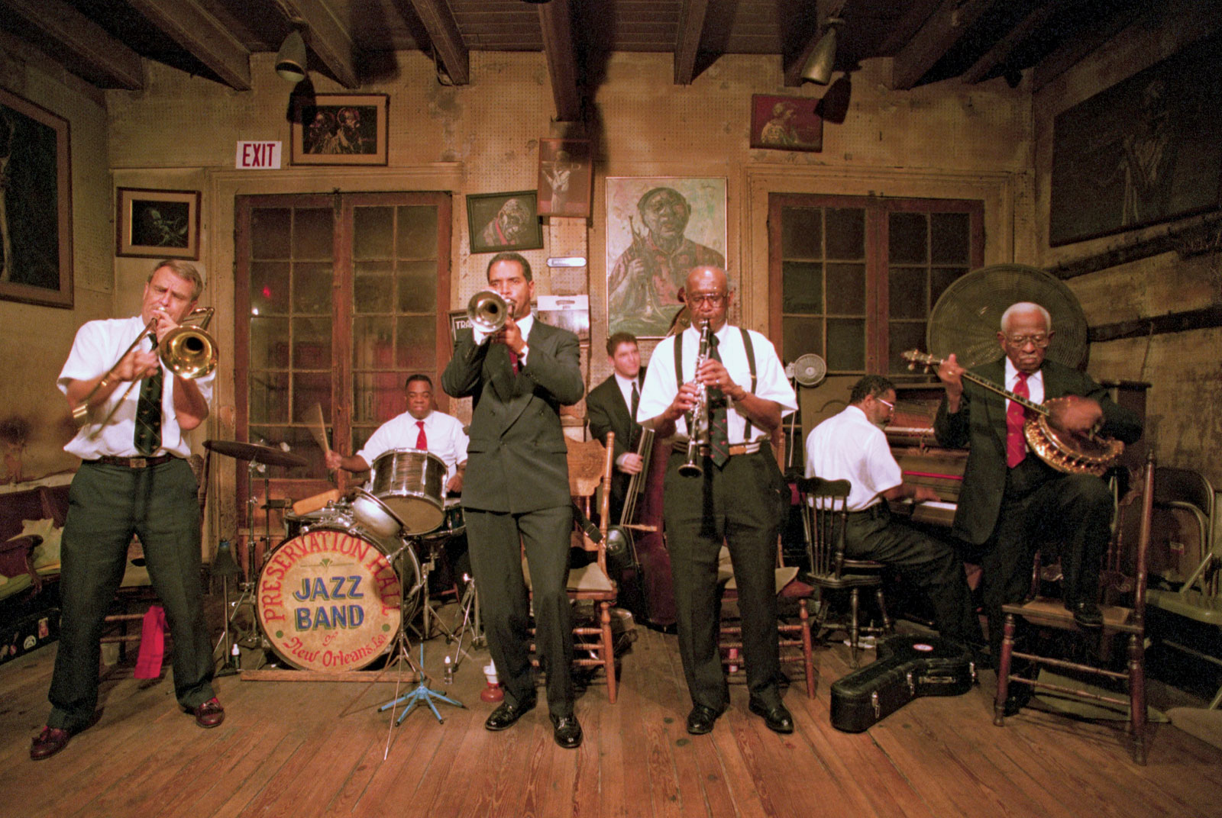
IV. American Popular Music since 1900
New Orleans Jazz, sometimes referred to as Hot jazz or Early Jazz, is a style of jazz music which developed in New Orleans at the start of the 20th century, and was spread to Chicago and New York City by New Orleans bands in the 1910s.

Slide 27
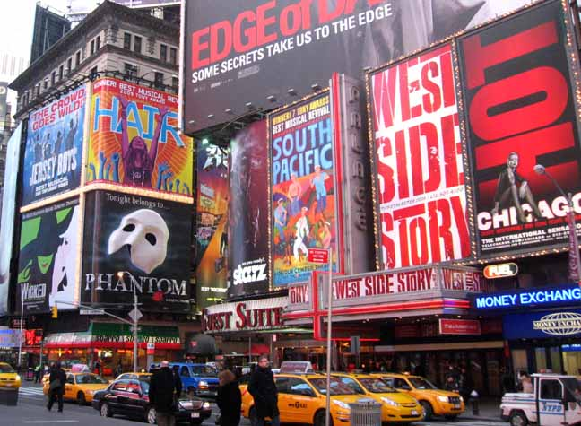
IV. American Popular Music since 1900
By the early 20th century, vaudeville shows helped spawn the development of Broadway musical theater and the songs of Tin Pan Alley.
Tin Pan Alley was an area called Union Square in New York City which had been the major center for music publishing towards the end of the 19th century.
Broadway, a boulevard running through Manhattan , refers to the American popular theater.

Slide 28
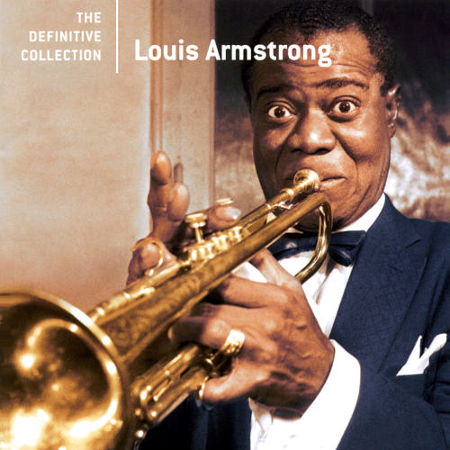
IV. American Popular Music since 1900
After World War I, the center of jazz music shifted from New Orleans north to Chicago, and New York.
The music of King Oliver’s Creole Jazz Band, and Louis Armstrong moved into the recording studio thanks to Thomas Edison’s invention which made recorded music possible, thus enjoy larger audience.
Louis Armstrong (1901-1971)

Slide 29
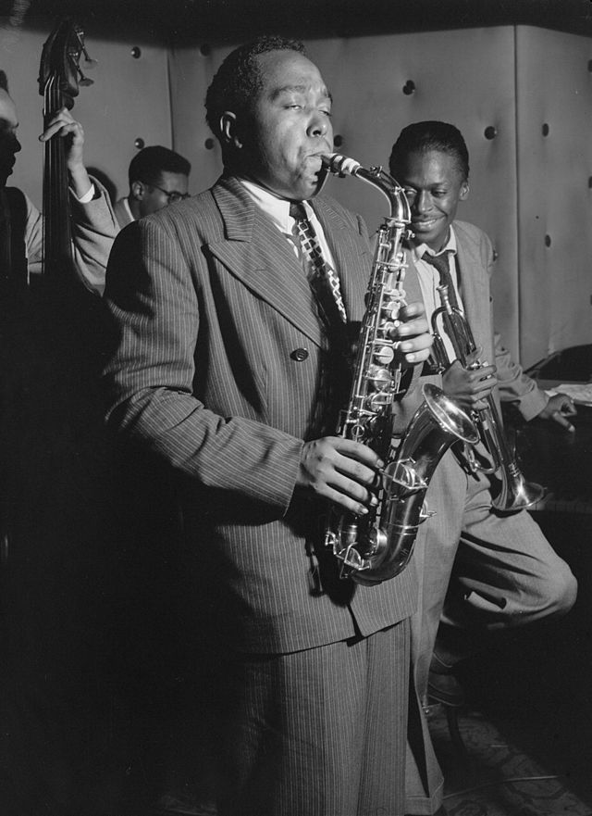
IV. American Popular Music since 1900
The three main characteristics of Jazz music:
-blue notes;
-syncopation;
-swing, call and response, call and improvisation.
Some of the jazz bands of the 1920s included those of Harry Reser, Leo Reisman, and the Yardbird.
Charlie Parker (1920-1955) also known as "Bird", was an American jazz saxophonist and composer.

Slide 30
IV. American Popular Music during the 1950s
The 1930s and 1940s was an age of swing. Swing music was dance music, and many of the most famous bands were heard regularly on the radio.
In the early 1940s, musicians also developed a style called be-bop. Be-bop ensembles were small groups of soloists who often improvised, pushing their instruments and voices to the limits of their physical capabilities and audience tolerance.
During the1950s, the following three popular music styles combined to make a new genre. The first was called “pop,” and it served most Americans. The second style, called “rhythm-and-blues,” came from the blues sung by black performers. Two of the most popular rhythm-and-blues performers of the 1940s and early 1950s were Chuck Berry and B. B. King. The third style is called “country-and-western,” including the commercialized folk music of the rural South and the cowboy music of the Southwest.

Slide 31
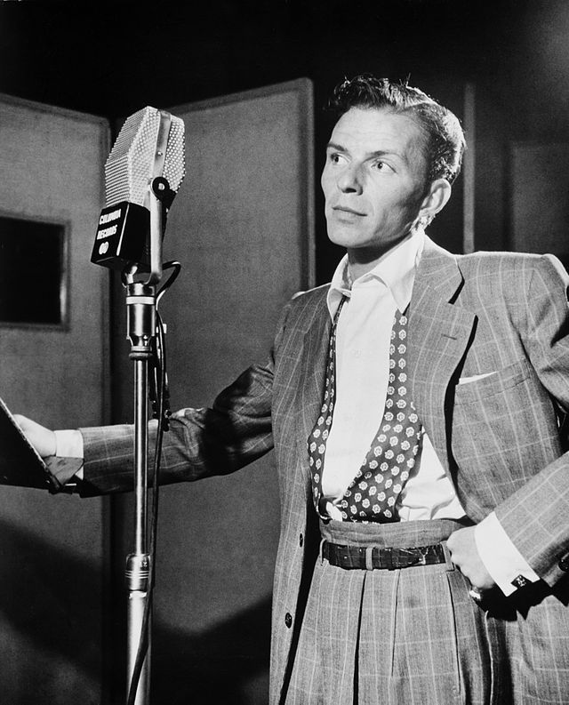
V. American Popular Music since the 1950s
The first style was called “pop,” and it served most Americans. Pop songs came from movies, Broadway musicals, and pop composers.
Frank Sinatra (1915-1998) was an American pop singer, actor, director, and producer.

Slide 32
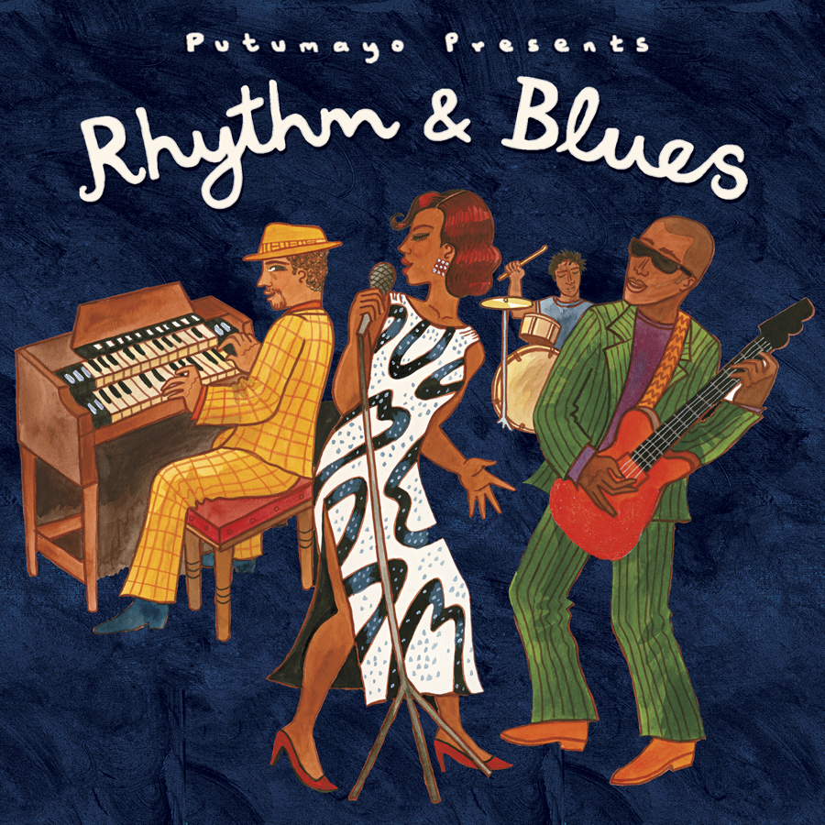
V. American Popular Music since the 1950s
The Second style “rhythm-and-blues” came from the blues which was the popular music of the African-Americans, played and sung in taverns and clubs or listened to on records in jukeboxes.

Slide 33
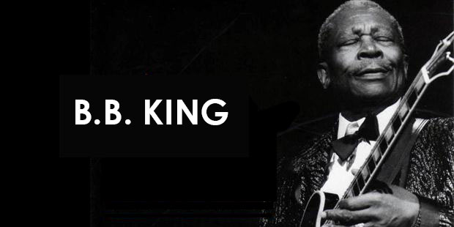
V. American Popular Music since the 1950s
Riley B. King (1925-2015 ), known by the stage name B.B. King, is an American blues musician and guitarist. Rolling Stone magazine ranked him No. 6 on its 2011 list of the 100 greatest guitarists of all time.

Slide 34
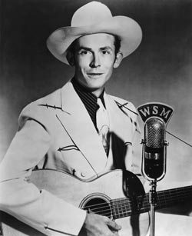
V. American Popular Music since the 1950s
The third style is country music, the center of the music being Nashville, Tennessee.
The popular singers of the 1950s included Hank Williams and Johnny Cash.
Hank Williams （1923-1953）

Slide 35
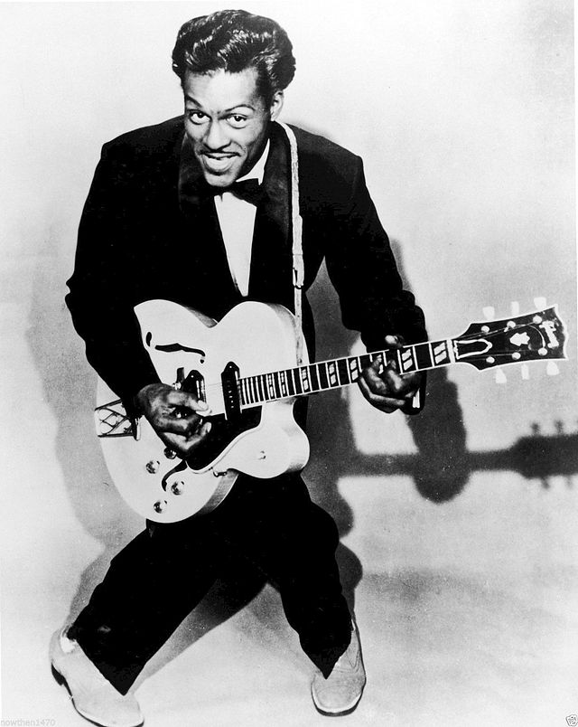
V. American Popular Music since the 1950s
Rock and roll was the result of these three separate styles that came together in the early 1950s.
The term “rock and roll” was first used by a Cleveland disc jockey named Alan Freed .
Between 1951 and 1954, R&B music was very popular among the white adolescents.
Charles "Chuck" Berry (1926- ) is an American guitarist, singer and songwriter,

Slide 36
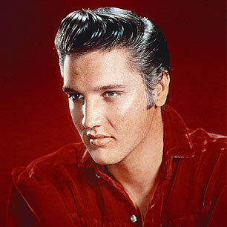
V. American Popular Music since the 1950s
Rock was born as a result of changes in the music, broadcasting, advertising and entertainment industries.
Elvis Presley’s singing came to mean “rock and roll” all over the United States.
By the early 1960s, rock had spread across the Atlantic to England, where The Beatles became most popular. They “invaded” the U.S. with huge impact after 1964.
Elvis Aaron Presley (1935 –1977) was an American singer and actor.

Slide 37
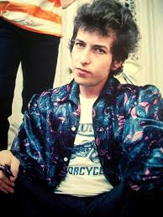
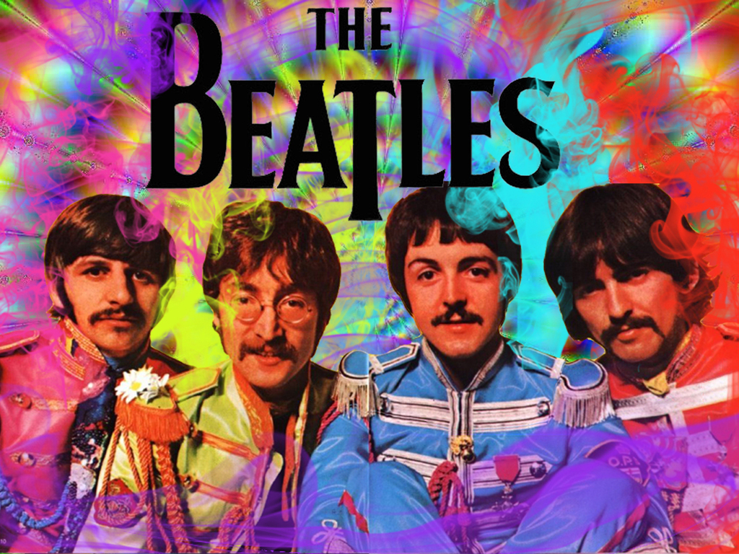
V. American Popular Music since the 1950s
The Beatles were an English rock band that was formed in Liverpool in 1960.
Bob Dylan contributed to the folk music revival, and the subsequent rock, or folk rock in 1965.

Slide 38
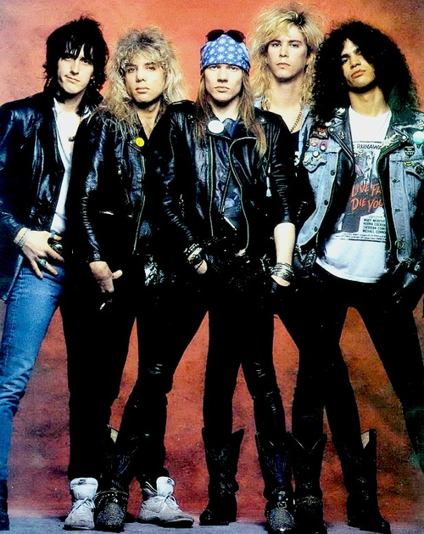
V. American Popular Music since the 1950s
In the 1970s and 1980s rock, political and sociological involvements have given way to personalization, and groups have given way to individual performers.
This is also the time when the mass protests against racial injustice and the war in Vietnam disappeared.
By the end of the 1980s, pop rock largely used images derived from the British rock movement, accompanied by hard rock music and heavy metal solo singing.
Guns N' Roses is an American hard rock band formed in Los Angeles, in 1985.

Slide 39
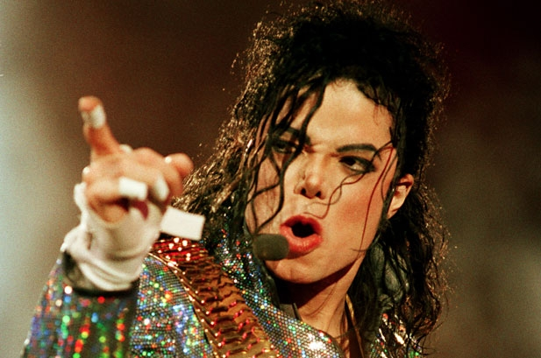
V. American Popular Music since the 1950s
The 1990s opened with an influx of Grunge music from Seattle. Nirvana is recognized as one of the very first Grunge bands to become more popular than Michael Jackson in 1991.
Alternative style of rock became mainstream after being signed on to music companies.
Hip-hop is an cultural movement, along with graffiti and breakdancing. The music is composed of rapping, the delivery of swift, highly rhythmic and lyrical vocals, and D-Jing.
Michael Joseph Jackson (1958–2009) was an American singer, songwriter, record producer,
dancer, and actor.

Slide 40
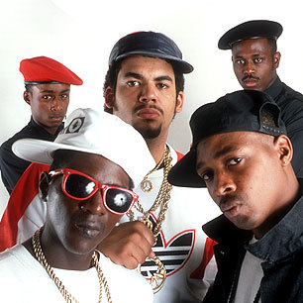
V. American Popular Music since the 1950s
Rap music has been black run and black created. Most important, it was not created to cater to a white audience at all.
They introduced social and political elements from the black community into their music.
Public Enemy is an American hip hop group consisting of Chuck D, Flavor Flav, DJ Lord, The S1W group, Khari Wynn and Professor Griff.

Slide 41
Conclusion
American popular culture is a commercial culture, mass produced for mass consumption.
After World War II, popular culture was undeniably associated with commercial culture and all its forms including music, film, television, advertising, sports, fashion, toys, magazines and comic books, and cyber culture, and any commodity available for purchase.
Popular music emerged early in the 19th century, and continued to develop during the rest of the 20th century with many new forms of music, using elements of blues, and other genres of American folk music.

Slide 42
Questions for Discussion
A. How is popular culture defined in the American context?
B. How useful is the “star system” in the making of American film industry?
C. In what way does jazz music help to express an American national identity?
D. How did DJ Alan Freed contribute to the making of rock and roll? Was he alone responsible for the creation of the music genre?
E. How did Bob Dylan manage to turn rock ‘n’ roll into rock, or folk rock? What makes folk rock different from early rock ‘n’ roll?
F. Why does the author say that hip hop is an on-going cultural movement? What are the major components of the music genre?

Slide 43
The End
高等教育出版社
2015

